Slide 1

Container With Most Water
Leetcode Problem 11

Slide 2
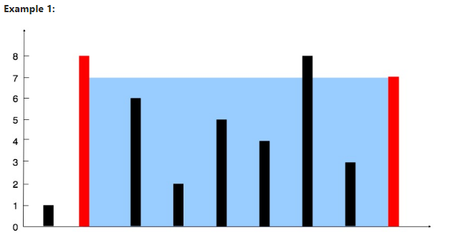
INTRODUCTION:
Problem Statement:
You are given an integer array height of length n. There are n vertical lines drawn such that the two endpoints of the ith line are (i, 0) and (i, height[i]). Find two lines that together with the x-axis form a container, such that the container contains the most water. Return the maximum amount of water a container can store.
Notice: that you may not slant the container.

Slide 3
Input: height = [1,8,6,2,5,4,8,3,7]
Output: 49
Explanation: The above vertical lines are represented by array [1,8,6,2,5,4,8,3,7]. In this case, the max area of water (blue section) the container can contain is 49.
Example 2:
Input: height = [1,1]
Output : 1
Constraints:
n == height.length
2 <= n <= 10⁵
0 <= height[i] <= 10⁴

Slide 4
Description:
  You are given an integer array height representing the heights of vertical lines.
  Find two lines that, together with the x-axis, form a container that holds the most water.
  Return the maximum amount of water that the container can store.
  Constraints: You cannot slant the container.

Slide 5
Approach Overview
Description:
  We'll use the Two Pointer technique to efficiently find the maximum water container.
  Initialize two pointers, left and right, at the beginning and end of the array.
  Move the pointers towards each other while calculating the area of each container formed by the lines.
  Update the maximum area found so far.

Slide 6
Code Explanation
Define a class Solution with a member function maxArea that takes a vector height as input and returns an integer.
Initialize variables n, left, right, d, min, and maxArea.
Use a while loop to iterate until left pointer is less than right.
Calculate min as the minimum height between the lines pointed to by left and right.
Calculate d as the distance between left and right.
Calculate maxArea as the maximum of the current maxArea and min * d.
Move left or right pointer inward based on the comparison of heights.
Return the maxArea after the loop exits.

Slide 7
Code Snippet
The complete C++ code of the Solution class along with its member function maxArea. The code snippet highlights key components such as variable initialization, the while loop, pointer movements, and the return statement:

Slide 8
class Solution {
public:
int maxArea(vector<int>& height) {
//Get the size of the input array
int n = height.size();
// Initialize left and right pointers
int left = 0;
int right = n - 1;
// Variables to store distance, minimum height, and maximum area
int d; // distance
int min, maxArea = 0;
// Iterate until left pointer is less than right pointer
while (left < right) {
// Determine the minimum height between the lines pointed to by left and right pointers
if (height[left] < height[right]) {
min = height[left];
CODE:

Slide 9
} else {
min = height[right];
}
// Calculate the distance between left and right pointer
d = right - left;
// Calculate the area formed by the current pair of lines and update maxArea if necessary
maxArea = max(maxArea, min * d);
// Move left or right pointer inward based on the comparison of heights
if (height[left] < height[right]) {
left++;
} else {
right--;
}
}
return maxArea;
}
};
CODE:

Slide 10
Complexity Analysis
Time Complexity: O(n) - Linear time complexity due to the single-pass iteration over the array.
Space Complexity: O(1) - Constant space complexity as no extra space is used other than a few variables.

Slide 11
Conclusion
In conclusion, we revisited the problem statement where we were tasked with finding two lines that, together with the x-axis, form a container holding the most water. We addressed this challenge by employing the Two Pointer technique.
This approach involves initializing two pointers, one at the beginning and one at the end of the array, and gradually moving them closer together while calculating the area of each container formed by the lines. By identifying the container with the maximum area, we determine the optimal solution.
We highlighted the efficiency and simplicity of our solution, which operates in linear time complexity, O(n), due to its single-pass iteration over the array. Additionally, the solution requires only constant space complexity, O(1), as it utilizes a minimal number of variables.
We invite questions and discussions from the audience to further explore the problem-solving process and encourage deeper understanding of the Two Pointer technique and its applications.

Slide 12
THE END

